Slide 1




Team no: MBH-01
Team Members:
Pankaj Diwan- ECE 4-2
Baradwaj- EEE 3-2
Kartikey- CSE 2-2
Sai Akshay- IT 1-2

Slide 2
Problem Statement
Paitent Details are accessable in emergency at situations for better treatment, Very delayed process for insurance, No Patients data Exchange Between Hospitals.

Slide 3
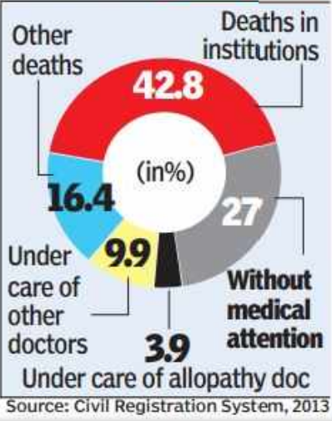
Statistics
Percentage of deaths in India happen with no Proper treatment at right time.

Slide 4
Present Scenario
Applications for few hospitals where you can store test reports and also prescriptions.
Patients should carry reports with them.

Slide 5
Proposed Solution
Transpareny of Treatment to all hospitals through Distributed System with a single source of entry.
Insurance gets applied without human interface.

Slide 6
Stake Holders
Insurance Companies
Medical Agency
Diagnostic Center

Slide 7
Smart Contract
Registration of Patients and Doctors
Entry and Storage of patients details
If person have Insurance applicable to treatment, It directly Starts Process.
Medical Agency can get Prescription Directly

Slide 8
References
→ https://timesofindia.indiatimes.com/india/27-of-deaths-in-India-for-want-of-medical-attention/articleshow/49474537.cms

Slide 9
Thank You
Team no: MBH-01

